Slide 1

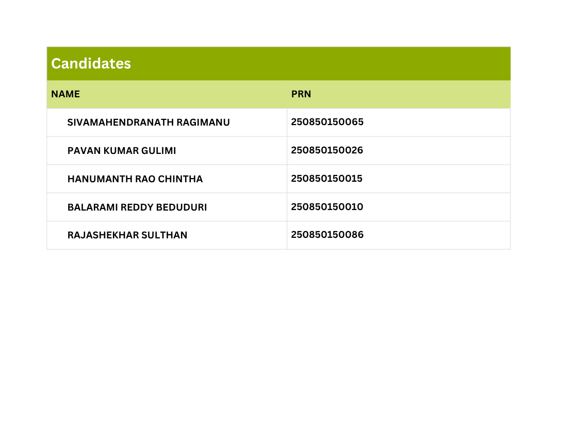
AI- Powered Healthcare Knowledge Graph Generator using LLM
Mid-Review Presentation
Project Guide: N Snathan, Scientist-E
CDAC- Bangalore

Slide 2
Project Overview
-->>Objective:
To develop an AI-powered system that extracts and visualizes healthcare entities (Hospitals, Doctors, etc.) from text/web sources.
-->>Purpose:
Simplify healthcare data analysis
Automate data extraction and relationship mapping
Enable searchable, visual knowledge graph

Slide 3

Problem Statement & Motivation
-->>Problem:
Healthcare data is scattered and unstructured.
Manual linking of doctors, hospitals, and details is inefficient.
-->>Motivation:
Automate extraction and structuring using AI.
Support informed healthcare data insights.

Slide 4

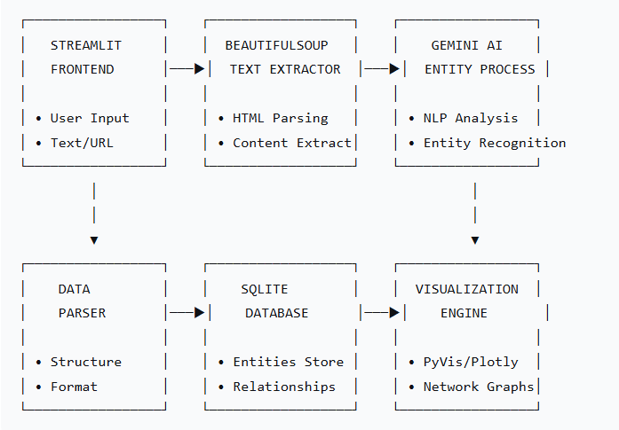


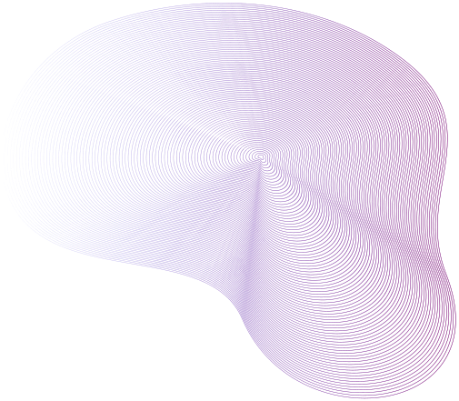
System Architecture

Slide 5



Technology Stack
Frontend: Streamlit
AI Model: Google Gemini API
Backend: Python
Database: SQLite
Visualization: PyVis, Plotly, NetworkX
Libraries: Pandas, NumPy, BeautifulSoup, dotenv, Matplotlib

Slide 6
Module Development Progress
Text Extraction – ✅ Completed
Gemini Integration – ✅ Completed
Entity Parser – ✅ Completed
Relationship Mapper – ✅ Completed
Database Integration – ✅ Completed
Visualization – 🔄 In Progress
Search & Insights – 🔄 In Progress

Slide 7
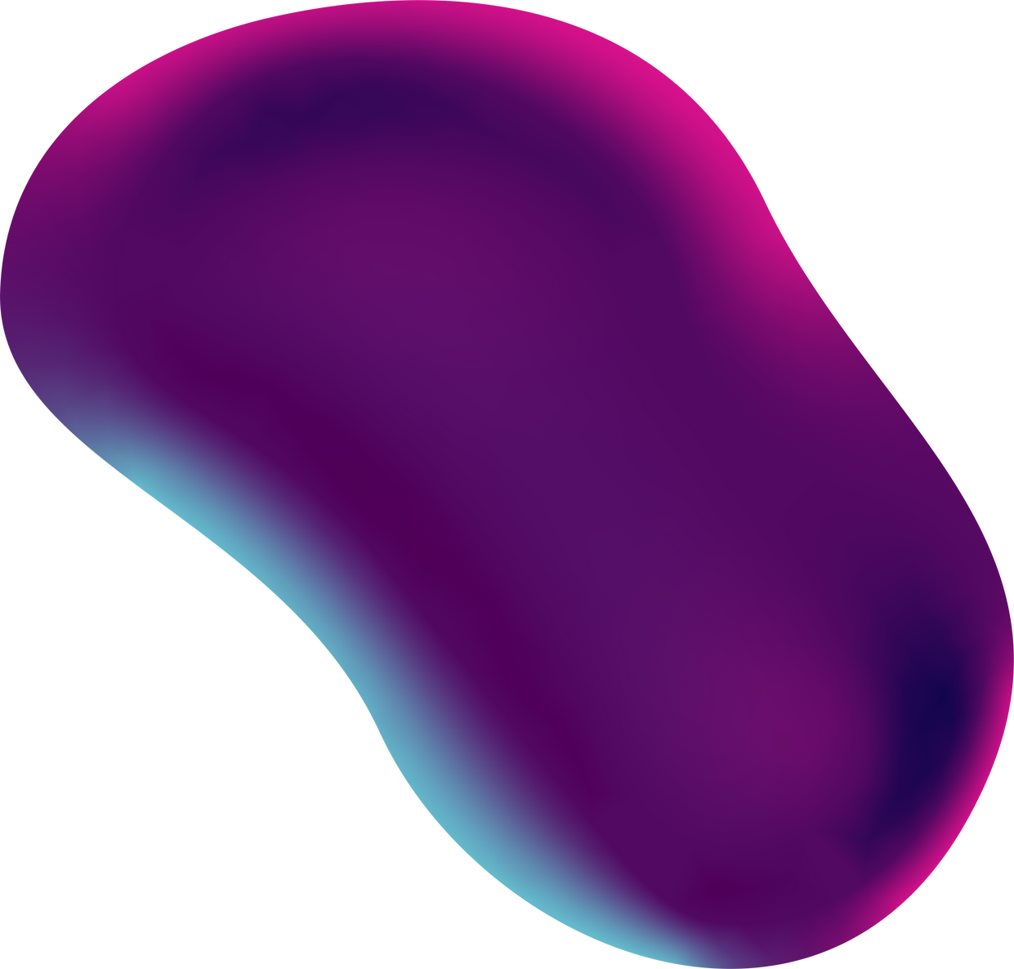
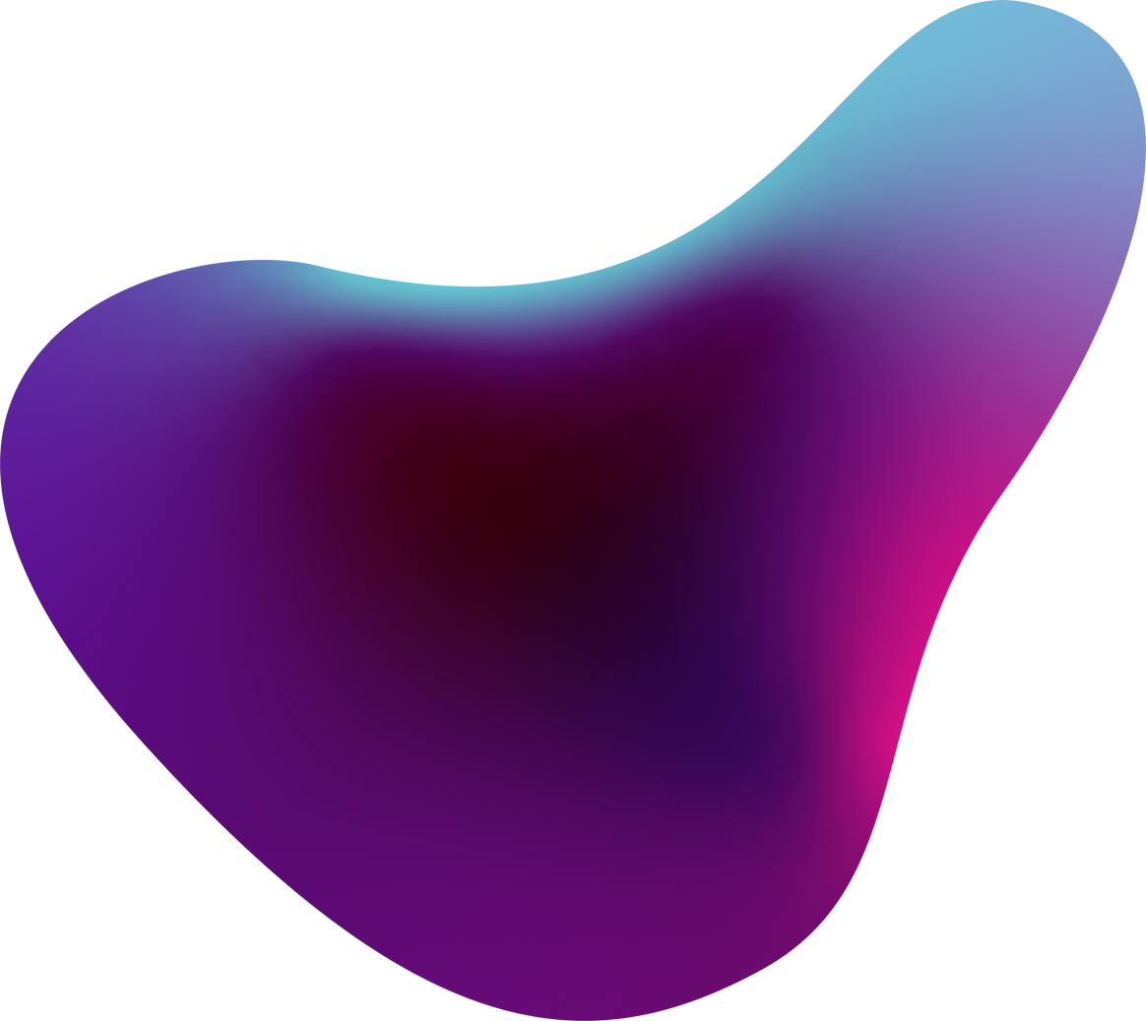
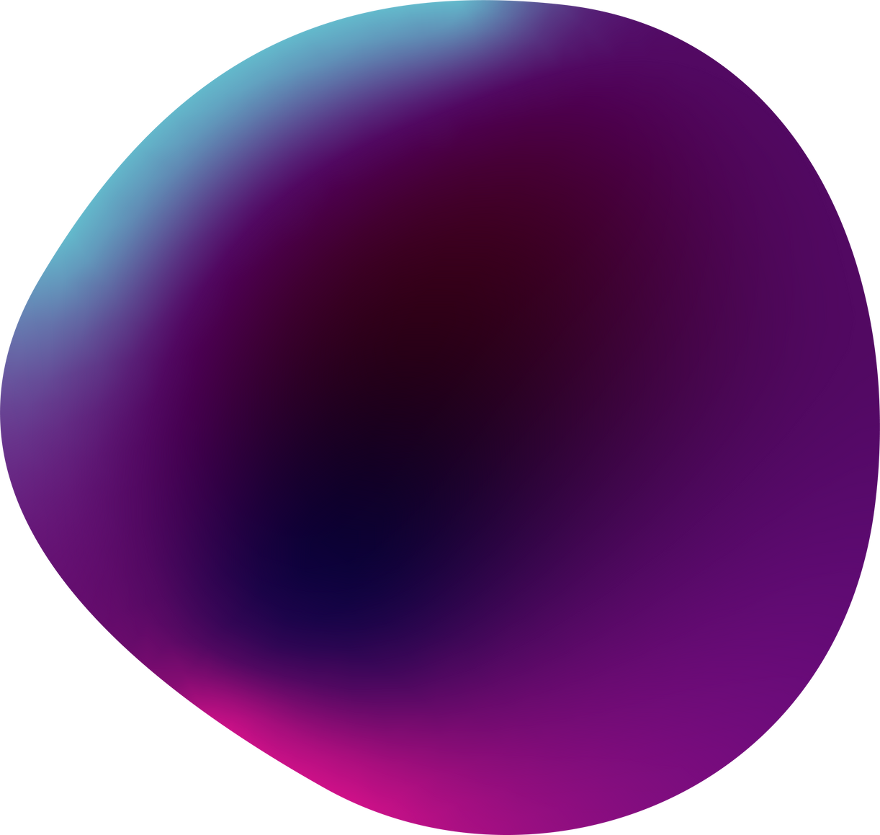
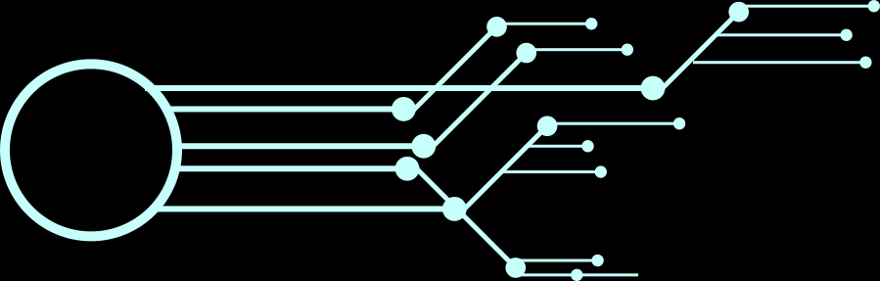
Key Functionalities Implemented
Entity extraction (hospitals, doctors, clinics)
Relationship mapping (e.g., Doctor works at Hospital)
Database integration with weight scoring
Visualization using interactive network graphs(in progress...)
09

Slide 8

Results & Outputs
Example Output:
Dr. Meera Jain → Works At → Apollo Hospitals
Database Snapshot:
Apollo Hospitals (Hospital, weight 2.0)
Dr. Meera Jain (Doctor, weight 1.8)

Slide 9
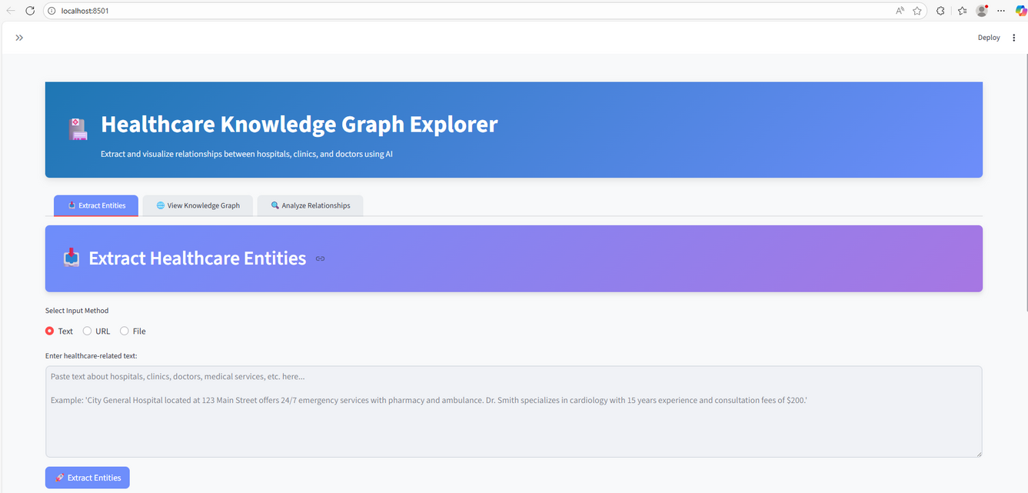

Slide 10
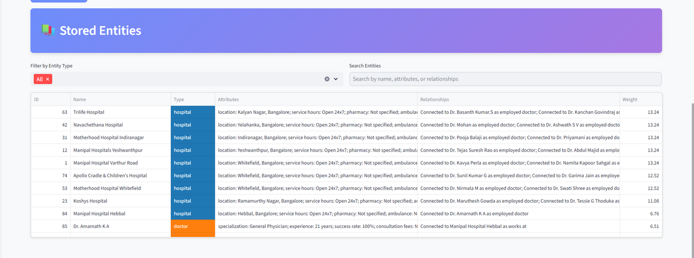

Slide 11
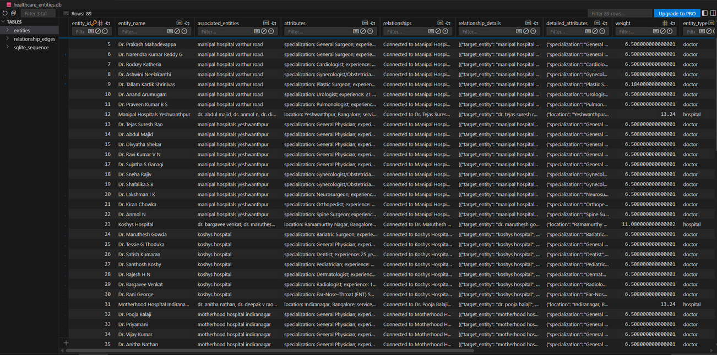

Slide 12
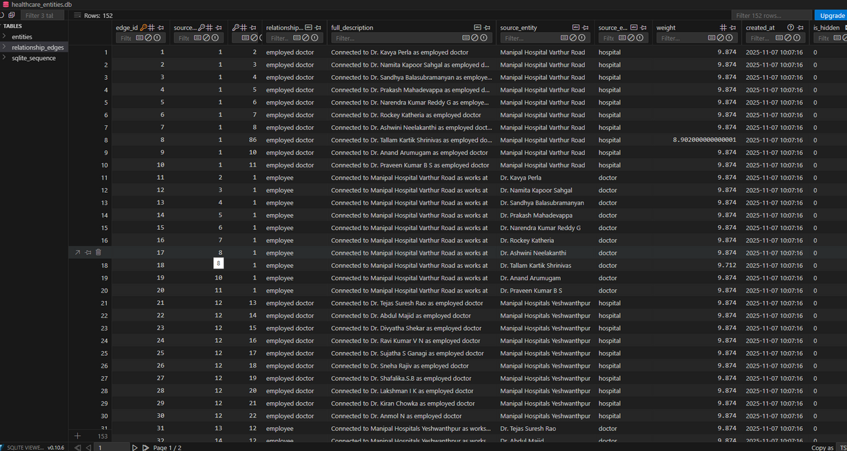

Slide 13
Future Work & Conclusion
-->> Future Enhancements:
Improve visualization & clustering
Cloud deployment (Streamlit/AWS)
Add authentication & extended entity support
-->>Conclusion:
AI-powered system for healthcare knowledge extraction & visualization successfully developed and functional.

Slide 14

Thank you

